Slide 1
Evolution (2014-2035-2050) of Solar Electricity (PV, CSP): LCOE Costs, Annual and Total CO2 Saved, and Financial Extra-costs, Based on the IEA Scenarios
José M. Martínez-Duart, Univ. Autónoma Madrid
Jorge Hernández-Moro, Univ. Autónoma Madrid
Meeting Energy Group, European Physical Society
Lisbon, November 13-14, 2014
European Energy Group Meeting, EPS, Lisboa, Nov. 13-14, 2014

Slide 2
REFERENCES
[1] J. M. Martinez-Duart, Photovoltaics firmly moving to the terawatt scale, J. Nanophotonics, 2013, 7, 078599.
[2] J. Hernandez-Moro, and J. M. Martinez-Duart, Analytical model for solar PV and CSP electricity costs: Present LCOE values and their future evolution, Renewable and Sustainable Energy Reviews, 2013 119-132.
[3] J. Hernandez-Moro, and J. M. Martinez-Duart, Main parameters influencing present solar electrici[ty costs and their evolution (2012-2050), JRSE 5, 023112 (2013).
[4] R. Guerrero-Lemus, and J. M. Martinez-Duart: Renewable Energies and CO2: Cost analysis, environmental impacts and technological trends, 2013 Springer-Verlag, London.
[5] J. Hernández-Moro, and J. M. Martinez-Duart, Economic analysis of the contribution of photovoltaics to the decarbonization of the power sector, RSER, 41, 1288-1297 (2015).
European Energy Group Meeting, EPS, Lisboa, Nov. 13-14, 2014

Slide 3
International Energy Agency (IEA) Scenarios
Blue Map Scenario (also called 2D Scenario):
The most relevant Scenario in our opinion. Tries to limit the global warming to 2ºC, equivalent to a CO2 concentration of 450 ppm and half the 2005 emissions. PV and CSP would represent 6% and 5%, respectively, of the 2050 electricity mix (total for solar: 11%)
Roadmap Scenario:
This IEA Scenario is the most optimistic Scenario, with a total implementation of 22% for the electricity mix in 2050; however, it is not a global Scenario for all technologies.
New Policies Scenario:
It is the Scenario with more limitations. It is based on the compromises on renewables made by some countries and it is defined only until 2035.

Slide 4
Mathematical Techniques
1.- Input: PV and CSP global targets of cumulative installed power and annual electricity, through 2050, according to several IEA Scenarios.
2.- Development of a mathematical model (closed-form expressions) for the calculation of the future (2013-2050) annual and total C- emissions avoided due to the PV and CSP deployment.
3.- Calculation of the financial extra-costs incurred in the implementation of PV and CSP systems replacing the traditional power generation mixes
European Energy Group Meeting, EPS, Lisboa, Nov. 13-14, 2014

Slide 5
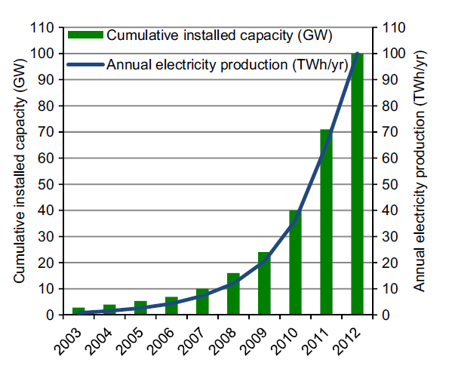
PV cumulative power and annual electricity production (2003-2012)
European Energy Group Meeting, EPS, Lisboa, Nov. 13-14, 2014

Slide 6
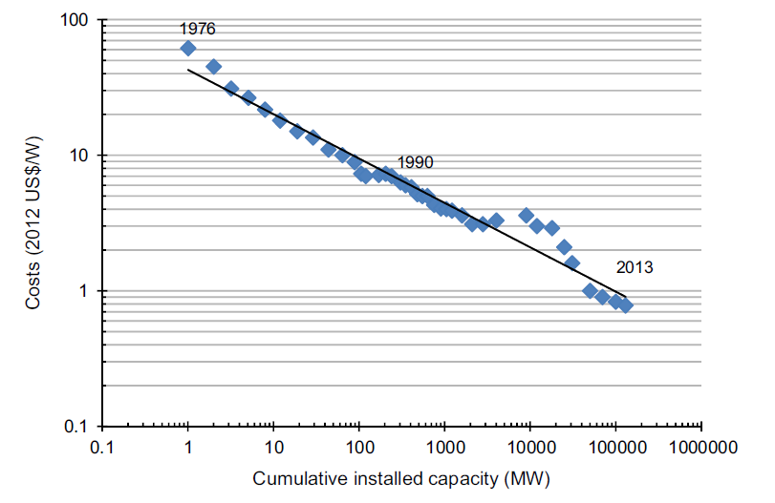
Learning Curve for PV modules (1976-2013)
European Energy Group Meeting, EPS, Lisboa, Nov. 13-14, 2014

Slide 7
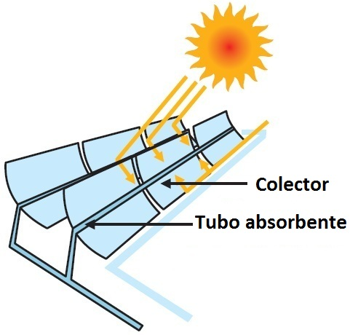
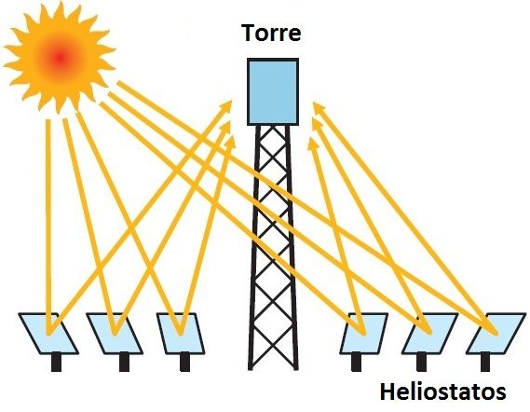
CSP systems: Trough and Tower
IV WMS, Council of Europe, Strasbourg, Oct. 14, 2013

Slide 8
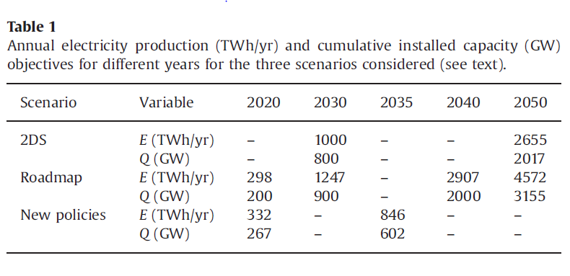
T. 1: IEA targets: annual electricity and cumulative power
T. 2: Mathematical expressions for E(t) and Q(t), (2013-2050)

Slide 9
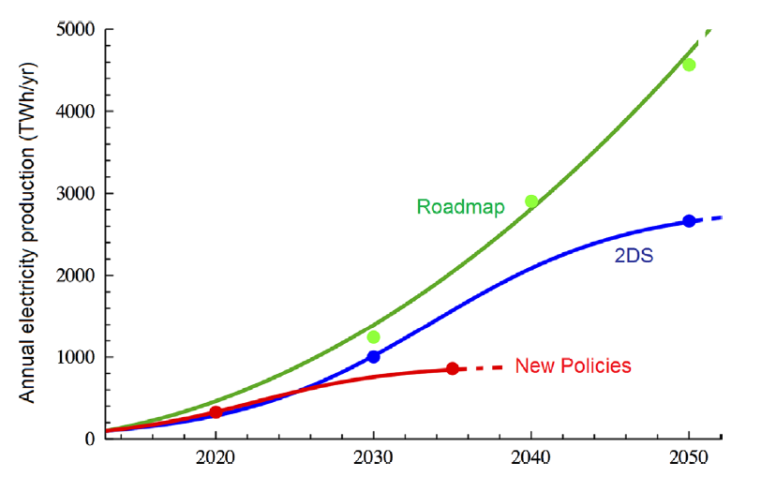
Simulation of PV annual electricity production
for the three IEA Scenarios considered
European Energy Group Meeting, EPS, Lisboa, Nov. 13-14, 2014

Slide 10
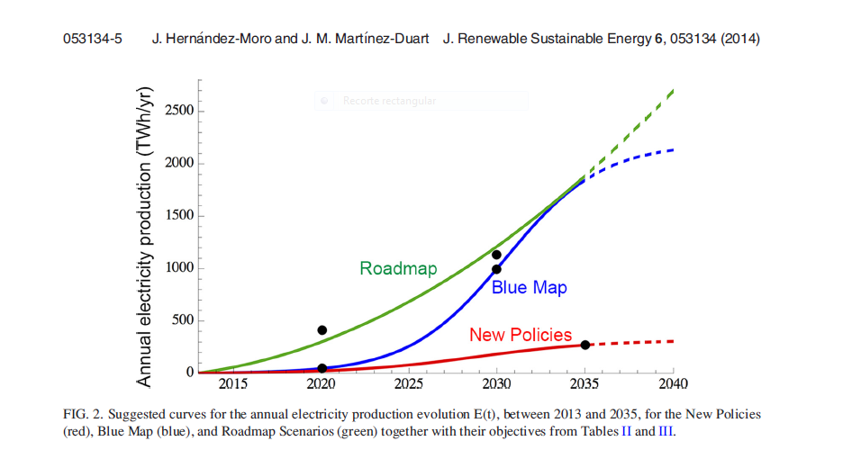
Simulation of CSP annual electricity production for the three IEA Scenarios considered
European Energy Group Meeting, EPS, Lisboa, Nov. 13-14, 2014

Slide 11
Analytical equations for the LCOE model
C | Cost of the system | I | Insurance cost
C(0) | Initial cost | N | Lifetime of the system
Q(t) | Cumulative installed capacity evolution | r | Discount rate
Q(0) | Initial cumulative installed capacity | S | Solar resource
LR | Learning rate | TF | Tracking factor
L | Land costs | η | Performance factor
OPEX | Operation & Management costs | d | Degradation rate
European Energy Group Meeting, EPS, Lisboa, Nov. 13-14, 2014

Slide 12
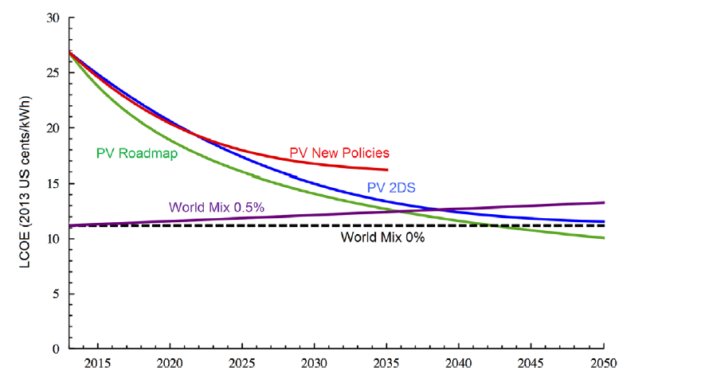
PV: LCOE costs evolution (2013-2050)
European Energy Group Meeting, EPS, Lisboa, Nov. 13-14, 2014

Slide 13
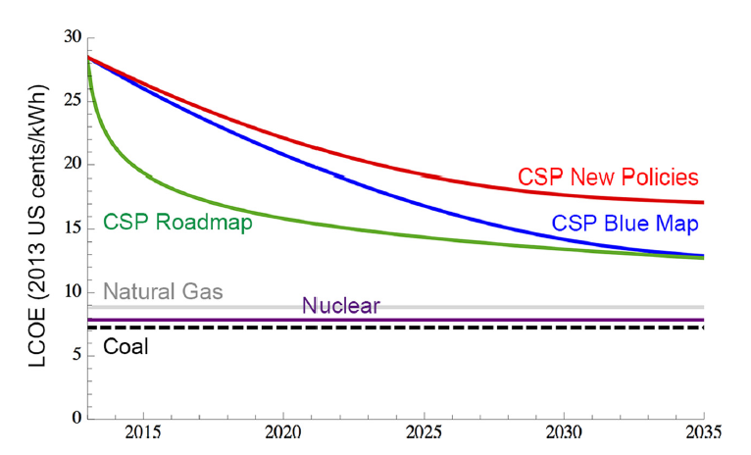
CSP: LCOE costs evolution (2013-2050)
European Energy Group Meeting, EPS, Lisboa, Nov. 13-14, 2014

Slide 14
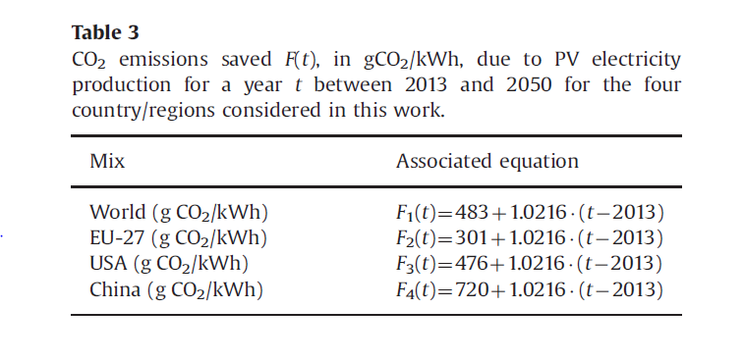
CO2 emissions saved
European Energy Group Meeting, EPS, Lisboa, Nov. 13-14, 2014

Slide 15
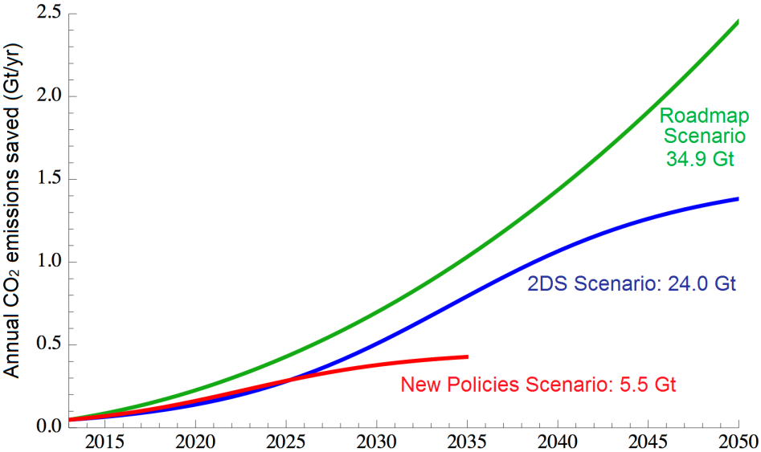
Calculation of annual and total avoided CO₂ emissions by PV and CSP technologies deployment
E(t): Annual electricity production
F(t): Annual emissions saved per kWh produced
PV
CSP
European Energy Group Meeting, EPS, Lisboa, Nov. 13-14, 2014

Slide 16
CSP: Avoided annual emissions (2013-2035) and total CO2 abatement
Scenario | Mix A | Mix B | UE-27 | USA | China
New Policies (GTon CO₂) | 1.97 | 1.31 | 1.11 | 1.68 | 2.46
Blue Map (GTon CO₂) | 6.58 | 4.38 | 3.80 | 5.72 | 8.40
Roadmap (Gton CO₂) | 9.60 | 6.39 | 5.44 | 8.18 | 12.01
European Energy Group Meeting, EPS, Lisboa, Nov. 13-14, 2014

Slide 17
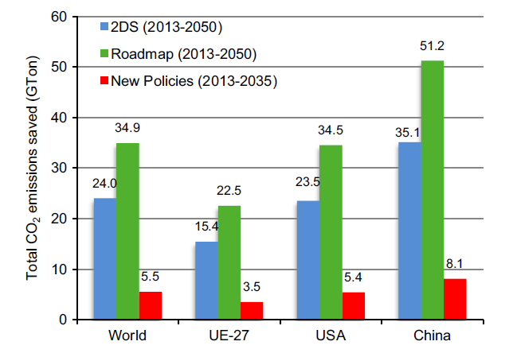
Total CO2 emissions saved (Gton) by PV: Global, EU, USA and China, three IEA Scenarios
European Energy Group Meeting, EPS, Lisboa, Nov. 13-14, 2014

Slide 18
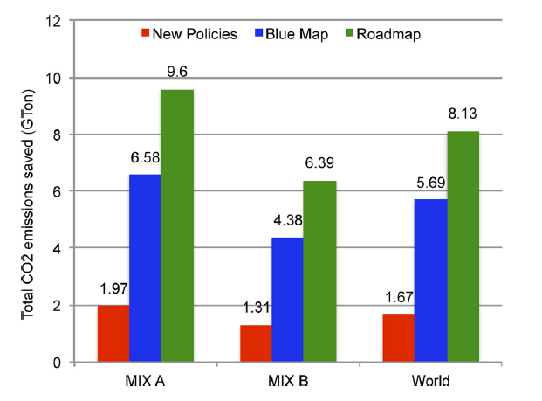
Total CO emissions saved (GTon) by CSP for several electricity mixes and Scenarios (2013-2035)
European Energy Group Meeting, EPS, Lisboa, Nov. 13-14, 2014

Slide 19
Calculation of annual and total extra-costs for PV and CSP deployment, repowering included
If “t<2043” and “x-t<30”:
If “t<2043” and “x-t≥30”:
If “t≥2043”:
PV CSP
European Energy Group Meeting, EPS, Lisboa, Nov. 13-14, 2014

Slide 20
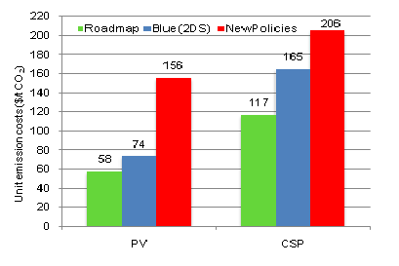
Unitary costs per avoided ton of emissions for PV and CSP (2013-2050)
European Energy Group Meeting, EPS, Lisboa, Nov. 13-14, 2014

Slide 21
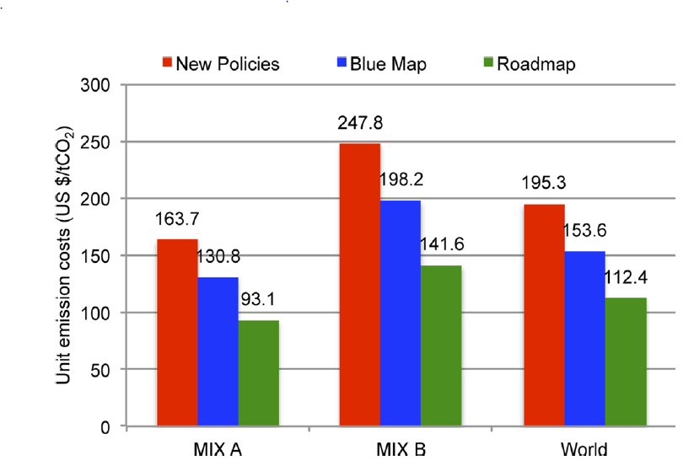
CSP: unit avoided emissions costs (2013-2035) for three electricity mixes
European Energy Group Meeting, EPS, Lisboa, Nov. 13-14, 2014

Slide 22
Thank you for your attention!!!
For further questions please contact:
martinez.duart@uam.es
European Energy Group Meeting, EPS, Lisboa, Nov. 13-14, 2014

